Slide 1

ToyLang: A Glimpse into Language Design
Explore the design and implementation of ToyLang, a mini-interpreted programming language built with C, Flex, and Bison. This presentation will walk you through its core features, architecture, and the journey of bringing a language to life.

Slide 2
Group Information :
Name : ID :
———— ———-
Md. Mehedi Hasan (0242220005101432)

Slide 3
Introduction
What is ToyLang?
1
2
3
A Learning Endeavor
Built with Core Tools
Simplicity & Functionality
ToyLang was developed as a hands-on project to understand the inner workings of programming languages, from lexical analysis to execution.
Leveraging C for its foundational logic, Flex for tokenization, and Bison for parsing, ToyLang showcases a traditional compiler design approach.
Designed to be minimalist yet functional, it supports essential programming constructs for demonstrating language principles.

Slide 4
Core Capabilities
ToyLang Features in Action
Syntax & Semantics
Code Example
Variables: Declare with dhoro, re-assign freely.
dhoro a = 10;dhoro b = 2;jodi (a > b) { dekhao "a is greater";} naile { dekhao "b is greater";}ghuraw (a > 5) { a = a - 1; dekhao a;}dekhao "Loop finished!";
Loops: ghuraw for conditional iteration (<, >, ==).
Arithmetic: Basic operations with division-by-zero checks.
Logic: && and || for complex conditions.
Output: dekhao for printing values and strings.
Conditionals: jodi / naile for branching logic.

Slide 5
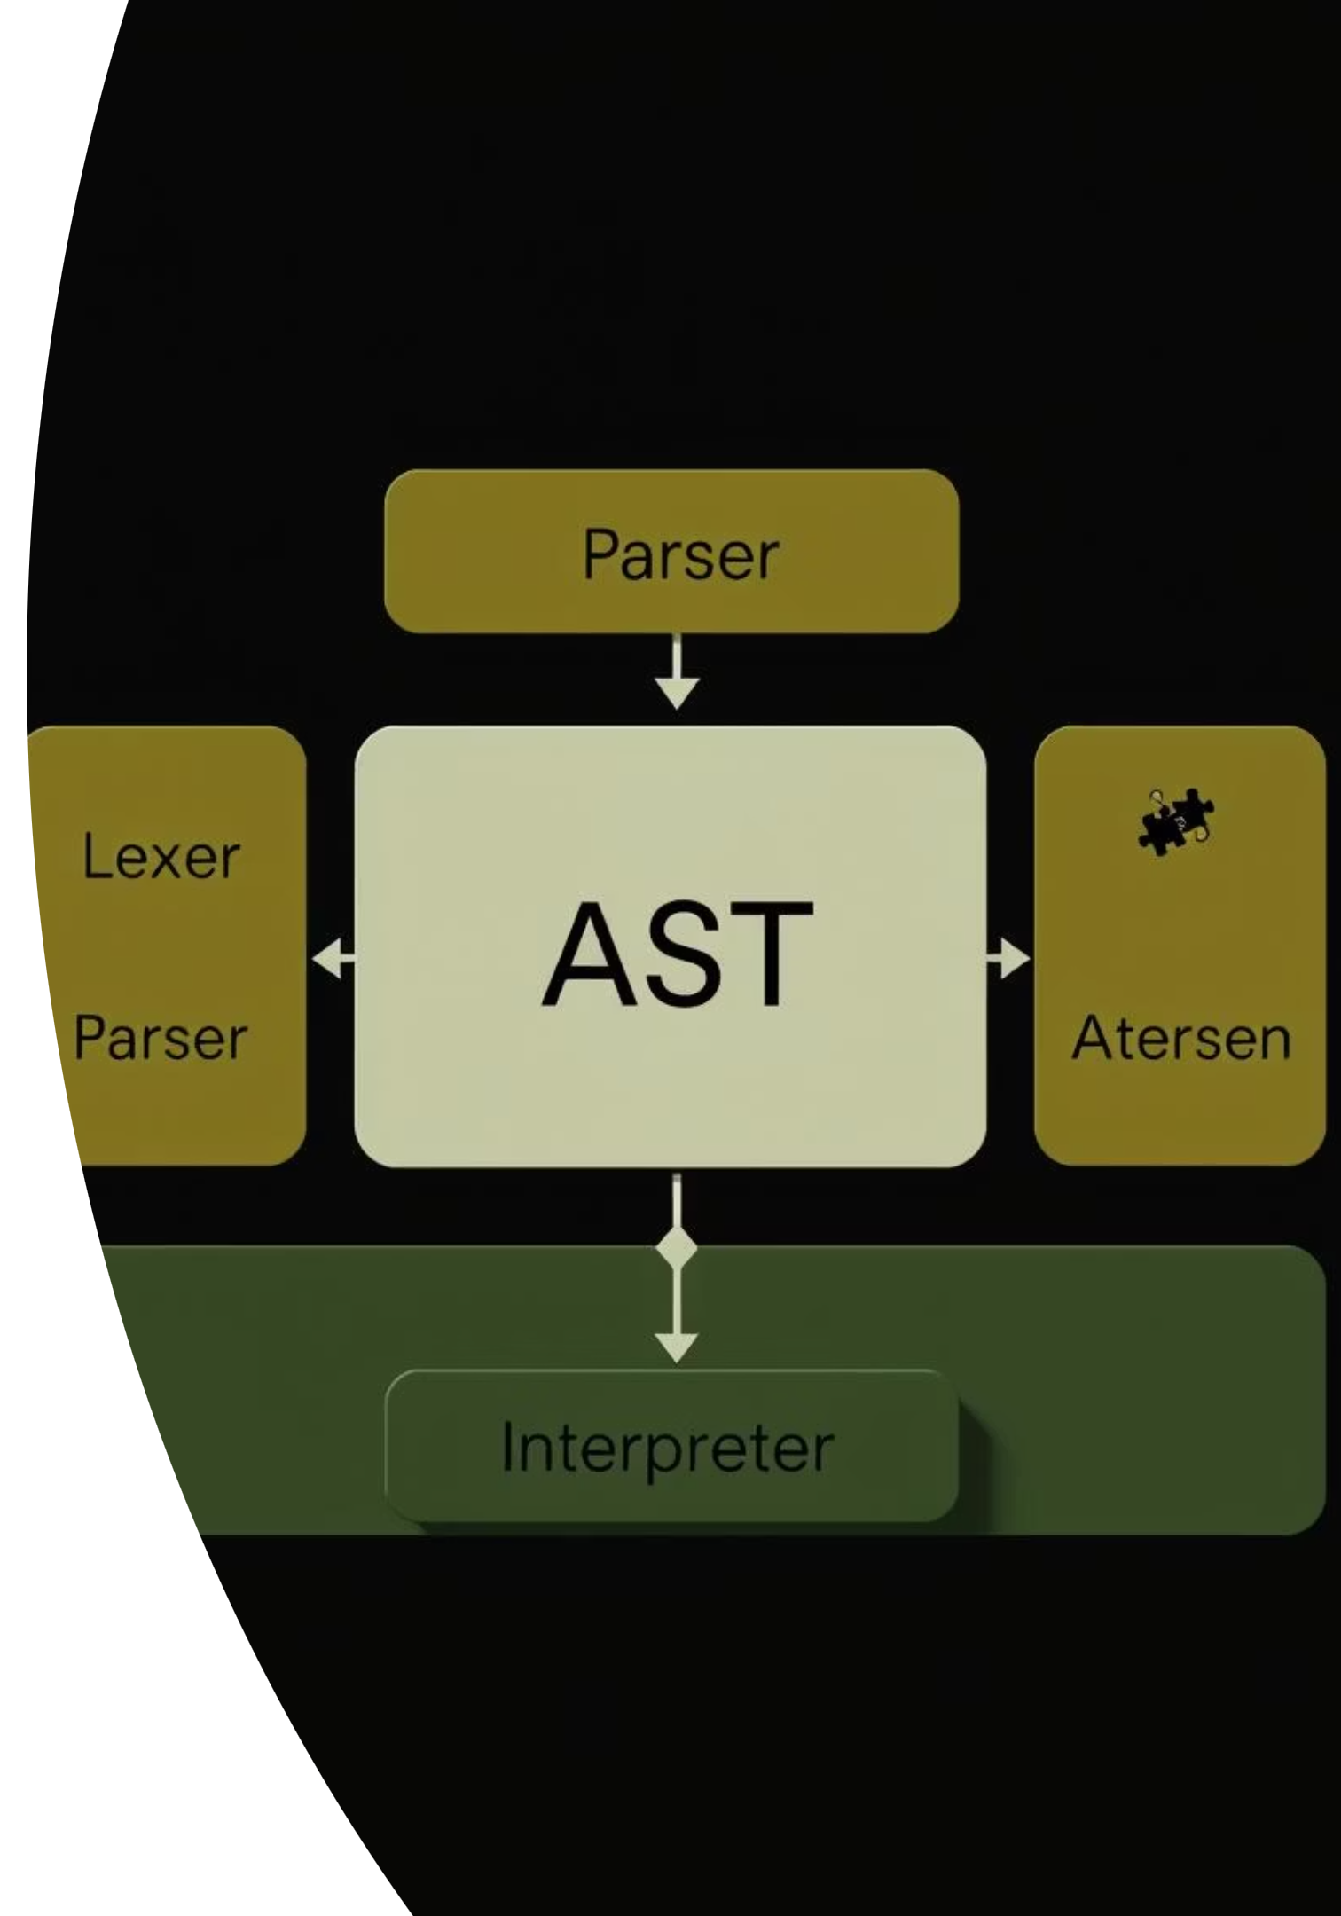
Under the Hood
Architectural Overview
ToyLang's architecture follows a classic interpreter design, breaking down the complex task of code execution into modular and manageable components.

Slide 6






From Source to Execution
The ToyLang Code Flow
Source Code (.toy)
Your ToyLang program, written in a .toy file.
Lexer (toy.l)
Tokenizes the source code, breaking it into meaningful units (keywords, identifiers, operators).
Parser (toy.y)
Takes tokens and builds the Abstract Syntax Tree (AST), representing the program's structure.
AST (ast.h)
The hierarchical representation of the program, used by the interpreter for execution.
Interpreter (main.c)
Traverses the AST, evaluates expressions, and executes statements.
Output
The result of your program's execution.

Slide 7
Live Example
A Simple ToyLang Program
Input: loop_example.toy
Expected Output:
dhoro counter = 1;dekhao "Starting loop...";ghuraw (counter <= 3) { dekhao "Current count: "; dekhao counter; counter = counter + 1;}dekhao "Loop finished.";
Starting loop...Current count: 1Current count: 2Current count: 3Loop finished.
This example demonstrates variable declaration, print statements (for both strings and integers), and the ghuraw loop in action.

Slide 8
Current State
ToyLang's Present Limitations
No Function Support
Limited Data Types
The language currently lacks user-defined functions or standard library calls.
Only supports integers and strings; no floating-point numbers, booleans (explicitly), or complex data structures.
Basic Control Flow
No User Input
Missing break and continue statements for fine-grained loop control.
Programs cannot interactively receive input from the user.

Slide 9
The Road Ahead
Future Enhancements
Function Definition & Calls
1
Enabling modularity and reusability.
Enhanced Control Flow
2
Adding break and continue for loops.
User Input
3
Implementing a lo_dekhao (read) statement for interactive programs.
More Data Types
4
Introducing floating-point numbers and possibly arrays.
Error Handling Refinements
5
More robust and informative error messages.

Slide 10

Reflections
Key Takeaways from ToyLang
Lexer & Parser Foundations: Deepened understanding of how Flex and Bison translate raw code into structured data.
AST's Power: Realized the critical role of the Abstract Syntax Tree in representing program logic for interpretation.
Interpreter Design: Gained insights into recursive evaluation and symbol table management for execution.
The Language Journey: Appreciated the iterative nature of language development and the complexity behind seemingly simple features.

Slide 11
Thank You

